Slide 1
Git Integration Options for Jira https://github.com/bobk/jirapresentations
meetup.com - Princeton Lean Coffee Agile Meetup
Online Lean/Agile Lightning Talk – Mar 25, 2020
Bob Kozlowski - http://www.robertkozlowski.com
Versatile experienced Agile/SDLC/Jira/Windows/CI/CD DevOps engineer
25 years global FinServ IT experience - CSM, Azure, Windows, ITIL certs
available Apr 2020 for next contracting/advisory role

Slide 2
What is “Git Integration”?
BASICS
Functionality to automatically associate Git commits with Jira issues, so that everyone knows what code was written for a given issue
A process runs on the Jira side/the Git side/a third location to scan for commits + issues that are related (typically by including the Jira issuekey in the commit message) and record them, usually in the Jira issues themselves
EXTRA CREDIT
make Git additional commit information and statistics available in Jira, including extending JQL to support key Git parameters
perform certain basic Git commands from Jira
perform certain basic Jira actions from Git (via commit messages)

Slide 3
What Are The Benefits? Who Is The Customer? How Does This Improve Agility?
Anyone who needs to know what code was written for Jira issues and review it in a familiar environment – who coded this feature, how “big” was the change, what components were touched (developers)
Anyone who wants to (lightly) track progress against features and create automated issue lists for CI/CD releases based on commits (product managers, release managers, dev leads)
Anyone who needs to support the code in production, or be able to answer questions/resolve problems related to new functionality or security (operational support, helpdesk, security engineers/pen testers)
Anyone who needs to pull statistics on code relative to Jira issues such as complexity vs. commits, rollbacks of releases, bugs against features (scrum masters, dev leads)
Anyone who wants to automate certain Jira functions during code dev cycle (dev lead, DevOps engineers)
Anyone doing CI/CD who wants to build specific branches containing the code for specific Jira issues (release managers, DevOps engineers)

Slide 4
Product Landscape
Third-party Jira plug-ins (cloud, server)
e.g., Git Integration for Jira plug-in from BigBrassBand
scripts (home-grown or OSS)
use Jira and GitHub REST APIs + modules
e.g., jiragithub sync script (yes, it’s on GitHub)
Atlassian’s built-in integration (cloud, server)
GitHub’s built-in integration (cloud)
* using GitHub cloud specifically as an example - some products do not fully support GitHub Enterprise or third-party Git incarnations)
** GitHub has “issue” functionality, but not a strong customizable workflow model, and their integration marketplace is not yet as mature as Atlassian’s, IMO

Slide 5
Pros/Cons: Plug-In vs Script
Product | Pros | Cons
Plug-In | typically better integrated into Jira UI more functionality vendor support runs all the time - quick updates repo indexing handled on Jira server side can use Jira permissions to control actions | license cost stability is a major concern admin friction/elevated rights/migrations/testing can change Jira settings + add custom fields
Script | no license cost (but != free) stability not a major concern no admin friction can run just once a day manually, e.g., after offshore team leaves for the day you can understand, change and extend what it does if you have the source | no vendor support Less well-integrated into Jira UI no permissions model need to rack up and run yourself
(Above pros/cons are general and are not intended to represent any particular product.)

Slide 6
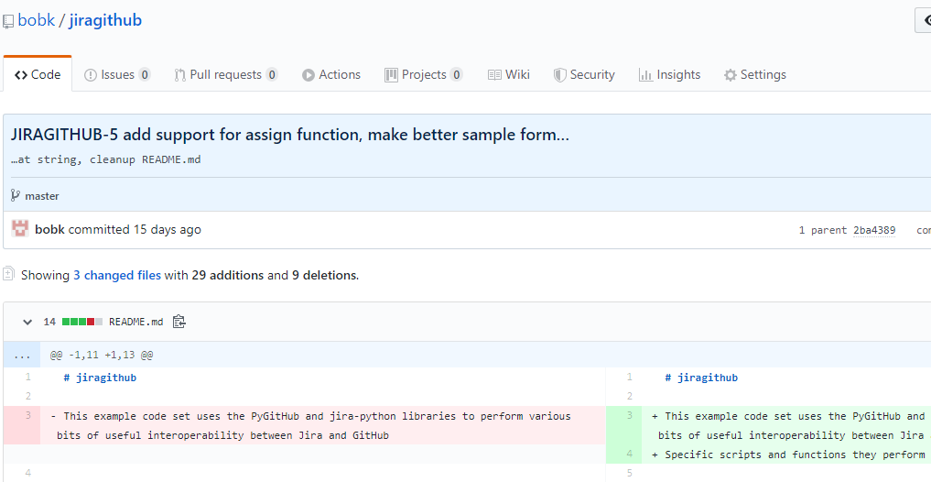
GitHub sample commit

Slide 7
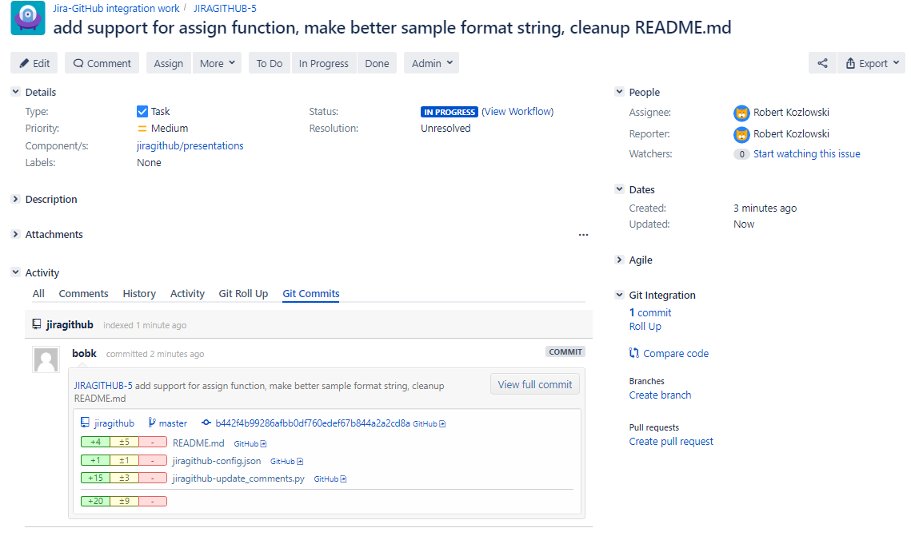
Git Integration for Jira plug-in from BigBrassBand

Slide 8
Git Integration for Jira plug-in from BigBrassBand Features
View Git commit/branch information in Jira
Places information in separate tab next to Comments, Work Log
“Smart Commits” – add comments, transition issues etc. via commit messages
Manually associate commits with issues when needed
Direct links to branches and commits
Git-specific JQL fields (gitCommitsReferenced, gitBranch)
Create branches from Jira
Create pull requests from Jira
Permissions model to control viewing Git data from Jira
My recommended option, if you choose to go the plug-in route
https://bigbrassband.com

Slide 9
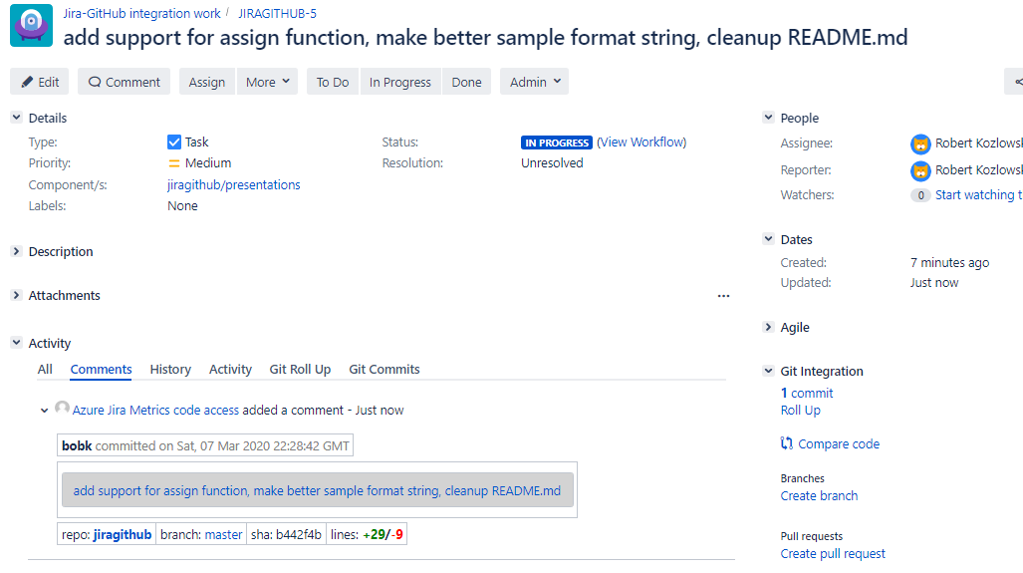
jiragithub script

Slide 10
jiragithub script Features
View Git commit/branch information in Jira
Places Git commit information in Jira as comments (user-definable format)
“Semi-Smart Commits” - transition + reassign issues via commit messages
Also inserts direct links to branches and commits
Control via easy-to-read config file
Schedule it to run with cron or Task Scheduler or as a CI job step
Run it under a Jira API key (cloud) or dedicated username (server)
Uses pyGitHub and jira-python libraries
Want a feature to work differently? Change it yourself!
My recommended option to start with, if you want to roll your own
http://github.com/bobk/jiragithub

Slide 11
Next Time?
Simple Jira Agile Metrics via Python and SQL (and Azure)
Jira Epic Thoughts and Jira Agile Tips and Tricks 1
Git Integration Options for Jira
Jira Issue Collectors and what to use them for
Python as poor-man’s Jira command-line or a Jira DSL (via jira-python/jirashell/pydsl)
Jira Agile Tips 2
Review of good Jira tech books

Slide 12
Questions/Feedback?
Thank You!
Robert Kozlowski
http://www.robertkozlowski.com

